Slide 1

Twitter Sentiment Analysis
112103147 – Vaishnavi Thakur

Slide 2
INTODUCTION
Twitter sentiment analysis is a vital task in natural language processing (NLP) that involves determining the sentiment expressed in tweets. With the explosive growth of social media, understanding sentiment on platforms like Twitter has become increasingly important for businesses, researchers, and policymakers.

Slide 3
PROBLEM STATEMENT
Develop a system capable of analyzing the sentiment of tweets on Twitter. The system should be able to categorize tweets as positive, negative, or neutral based on the emotions expressed in the text. The ultimate goal is to provide valuable insights for businesses, organizations, and individuals to understand public opinion.

Slide 4
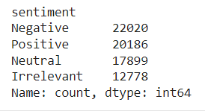
DATASET USED
Kaggle Twitter Dataset (for testing): https://www.kaggle.com/datasets/kazanova/sentiment140
Twitter Dataset Tableau: https://raw.githubusercontent.com/laxmimerit/All-CSV-ML-Data-Files-Download/master/twitter_sentiment.csv
Data size:
*Irrelevant tweets were extracted from official twitter website

Slide 5
PRE PROCESSING
Preprocessing is essential to clean and prepare the data for analysis. Here are the preprocessing steps performed in this project:
Removing rows with null values
Removing Stop words
Removing urls
Removing hashtags/mentions
Removing tweets less than 5 letters

Slide 6
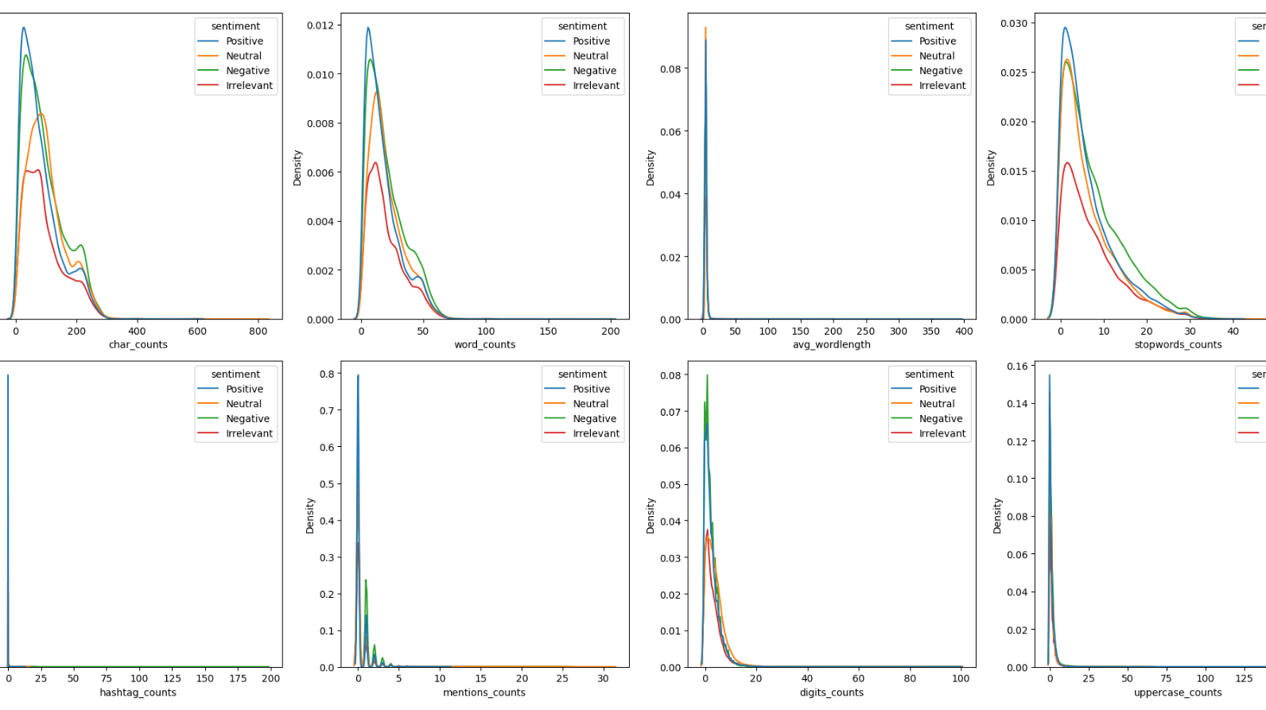
Data Visualization

Slide 7
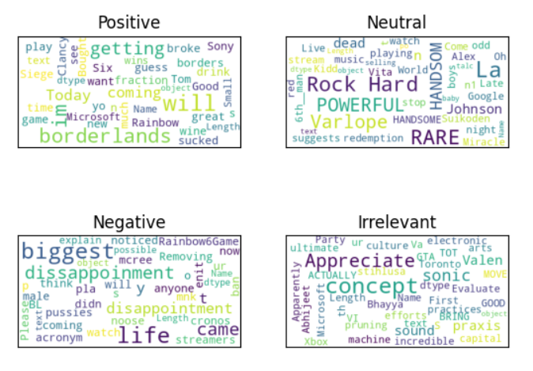
Word Cloud

Slide 8
COMPARISON WITH OTHER MODELS
Charecteristic | Random Forest | Logistic Regression | Decision Tree
Type of sentiments | +ve, -ve, neutral, irrelevant | Positive, negative | +ve, -ve, neutral
Time taken to train model | 4 minutes | 53 minutes | 2 minutes
Accuracy | 92% | 80% | 86%
Model size | 320 MB | 4 MB | 120 MB

Slide 9
CLASSIFIER USED
1. Random Forest is an ensemble learning method that combines multiple decision trees to make predictions.
2. Each tree in the forest independently learns from a subset of the training data and contributes to the final prediction through a voting mechanism.
3. In the context of Twitter sentiment analysis, Random Forest can effectively capture complex patterns in the text data and make accurate predictions about the sentiment expressed in tweets.

Slide 10
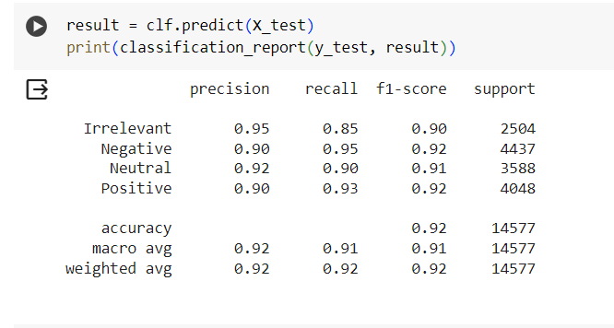
ACCURACY
The random forest algorithm gives approx. 92% accuracy.

Slide 11
CONCLUSION
Random Forest emerges as a powerful tool for Twitter sentiment analysis, offering robustness, scalability, and competitive performance. By leveraging ensemble learning and decision trees, Random Forest effectively captures the sentiment expressed in tweets and provides valuable insights for various applications. Continued research and experimentation with Random Forest and other machine learning techniques will further advance the field of Twitter sentiment analysis.

